Slide 1
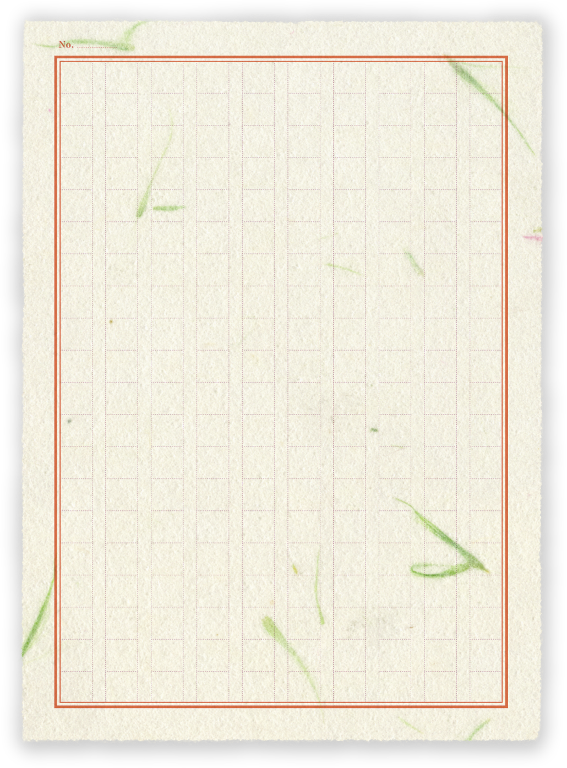
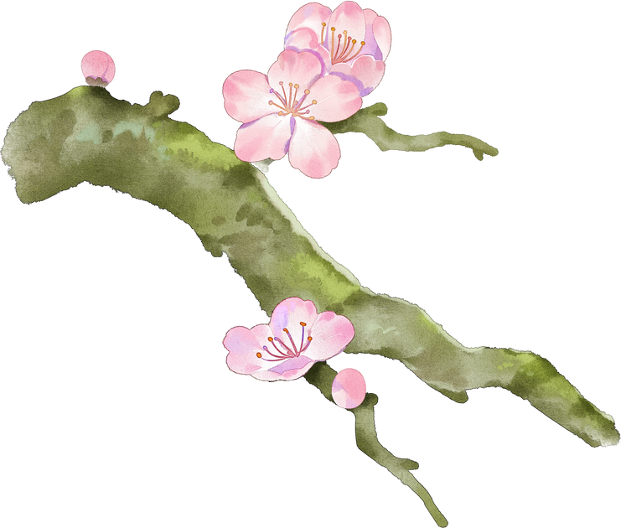


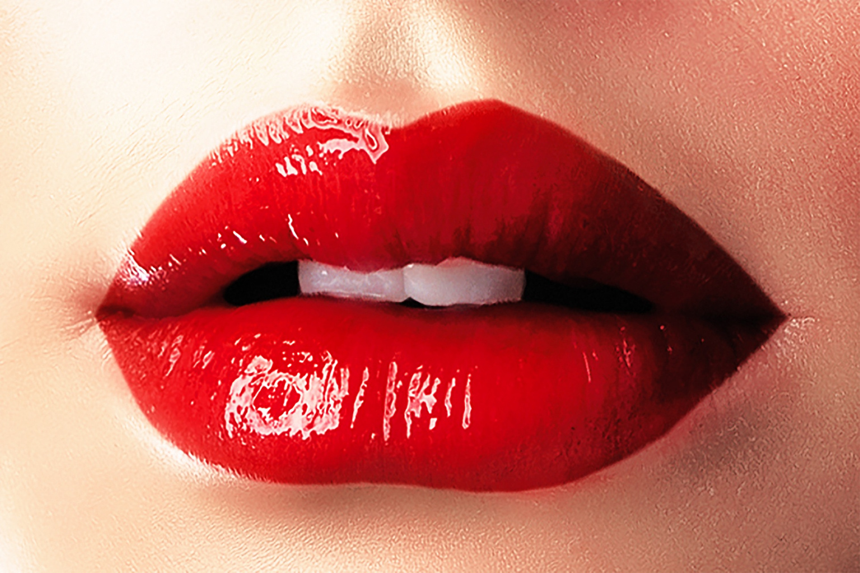


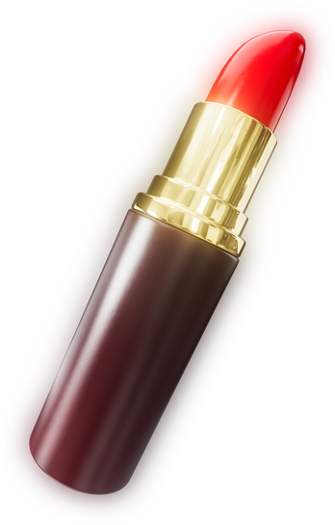


INSTAGRAM PERFORMANCE FOR
REPORT
byDebashish Borah

Slide 2

INTRODUCTION
Project Title: Instagram Performance Analytics for Sugar Cosmetics
Subtitle: Digital Marketing | Social Media Analytics | Data Analyst
Debashish Borah
Tools Used: Power BI | Google Sheets | Canva

Slide 3
PROJECT OVERVIEW
Objective:
Analyze Sugar Cosmetics’ Instagram performance to identify engagement trends and content strategies.
Business Goals:
Evaluate engagement and reach performance
Identify best-performing content types and times
Provide actionable insights for social media optimization

Slide 4
DATA SUMMARY & CLEANING
Dataset: 50,000 Instagram posts
Source Columns: Post Type, Campaign Type, Hashtags, Likes, Comments, Shares, Reach, Impressions, etc.
Cleaning Steps:
Checked for missing values (none found)
Removed duplicates (none found)
Outliers verified (valid)
Added calculated fields (Engagement Count, Rate, Month-Year, Weekday, Hashtag Count)
✅ Final Sheet: Cleaned_Data (ready for visualization)

Slide 5
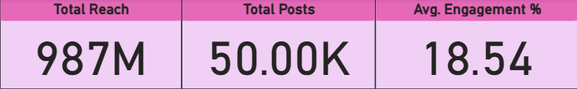
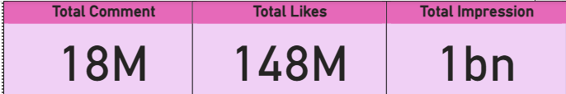
KEY KPIS (POWER BI CARDS)
MetricValue
Total Posts
50,002
Total Likes
147,728,279
Total Comments
18,459,361
Total Reach
987,423,288
Total Impressions
1,276,045,750
Avg Engagement Rate
18.53%
INSIGHT: SUGAR COSMETICS MAINTAINS STRONG ENGAGEMENT (~18%), INDICATING AN ACTIVE AND LOYAL INSTAGRAM AUDIENCE.

Slide 6
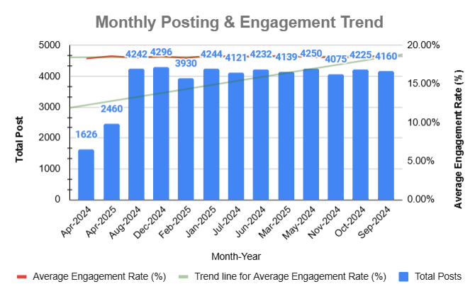
MONTHLY TREND
Insights:
Posting frequency remained consistent.
Highest engagement observed in Jan–Mar 2025.
Steady engagement rate around 18–19% shows stable content performance.
📌 Recommendation: Maintain posting consistency during high-engagement months (Jan–Mar) for campaigns and product launches.

Slide 7
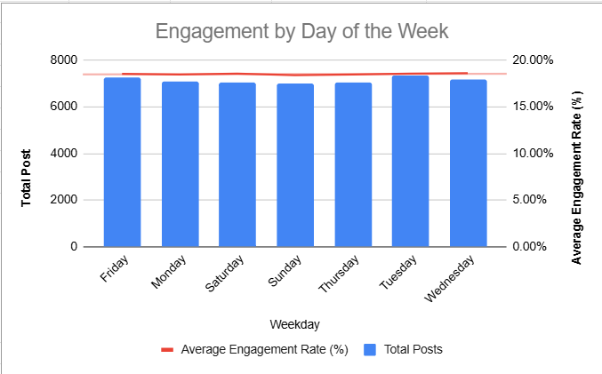
WEEKDAY PERFORMANCE
Insights:
Wednesday and Friday have the highest engagement rates.
Engagement slightly dips on weekends.
📌 Recommendation: Focus key content drops midweek (Tues–Fri).

Slide 8
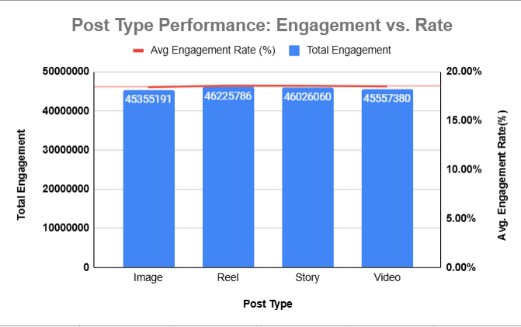
CONTENT TYPE PERFORMANCE
Insights:
Reels and Stories perform best (Avg ER ~18.6%)
Images show slightly lower engagement (~18.4%)
📌 Recommendation: Increase short-form video (Reels) usage; maintain Stories for interaction.

Slide 9
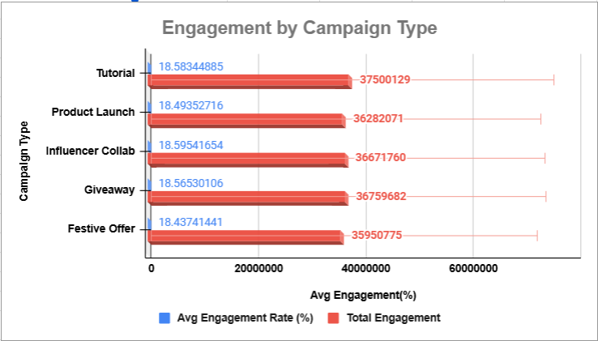
CAMPAIGN & EMOTION INSIGHTS
Insights:
Tutorials and Giveaways yield top engagement (~18.5%+).
Curious and Excited emotional tones drive the best reactions.
📌 Recommendation: Continue using curiosity-driven content and tutorial-style campaigns.

Slide 10
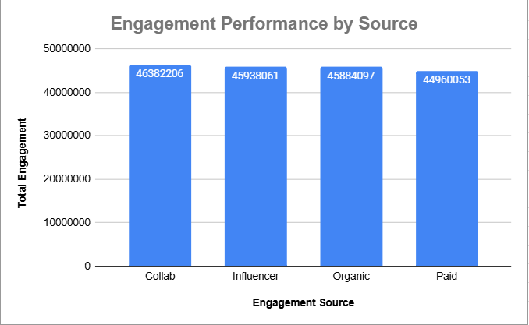
ENGAGEMENT SOURCE ANALYSIS
Insights:
Tutorials and Giveaways yield top engagement (~18.5%+).
Curious and Excited emotional tones drive the best reactions.
📌 Recommendation: Continue using curiosity-driven content and tutorial-style campaigns.

Slide 11
STRATEGIC RECOMMENDATIONS
Focus posting between Tuesday–Friday for maximum engagement
Boost use of Reels and Story formats
Maintain consistent posting in high-engagement months (Q1)
Highlight tutorial and giveaway campaigns
Use “Curious” and “Excited” tones in captions and visuals
Expand influencer collaborations

Slide 12
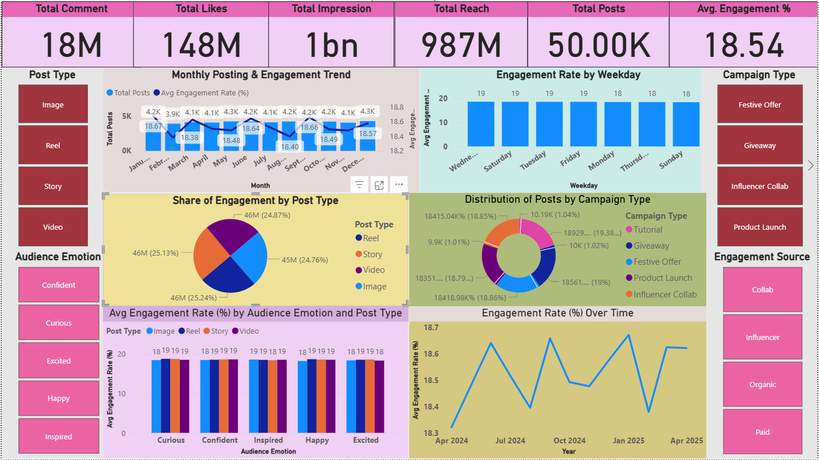
POWER BI DASHBOARD

Slide 13
THANK
YOU

